Slide 1

Don’t just go green, grow green.

Slide 2
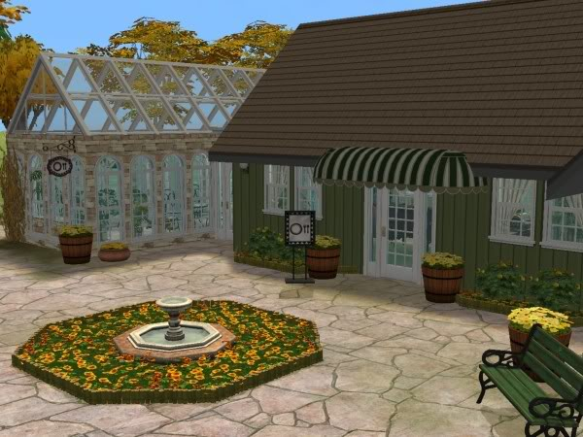
Information:
Willow Grove, PA
We offer high quality, healthy food
All ingredients are grown in a greenhouse attached to the restaurant
Guests are able to eat in the greenhouse (or inside the restaurant), eat delicious food, and on weekends enjoy live entertainment

Slide 3
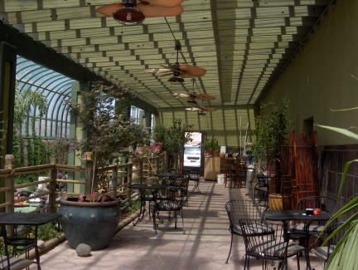
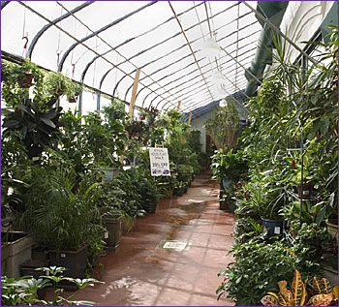
Atmosphere
Relaxed, family friendly
Seating inside the restaurant is
air conditioned and heated
Temperature in the greenhouse is always at 77˚ (to provide the optimum environment for our garden)

Slide 4
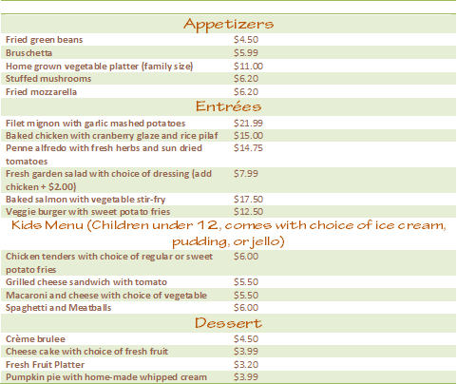
Fall Menu

Slide 5
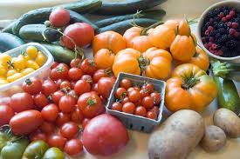
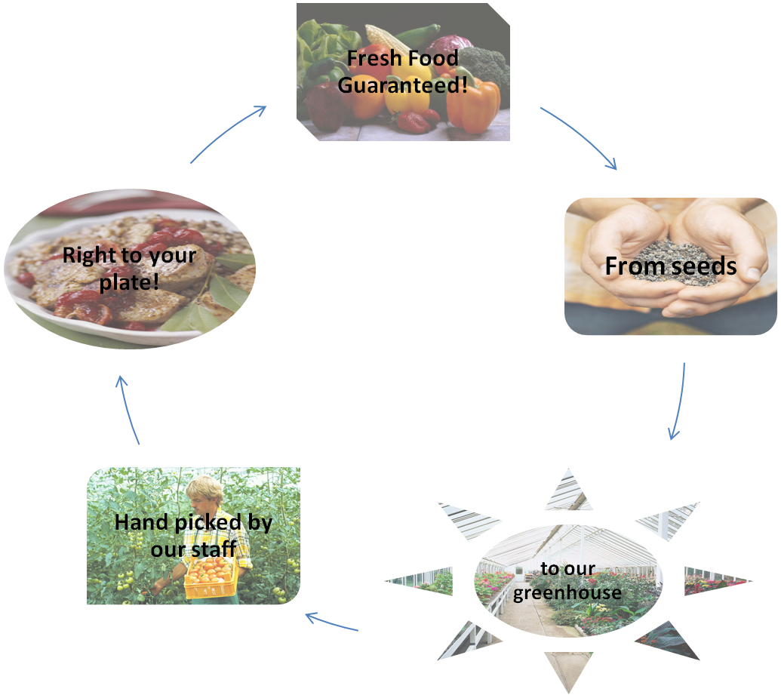
Cuisine:
Menu varies by season
Fresh, all natural ingredients
Children’s menu for children twelve and under
Specials on Sundays for senior citizens
No pesticides used in growing
Results in organic, healthy
dishes
Only the best for our
Customers!

Slide 6



If you have any additional questions feel free to contact us:
127 Vine Street
Willow Grove, Pennsylvania
Phone: 348-342-3454
Fax: 874-389-3455
Email: growinggreentogether@gmail.com
We hope to see
you soon!

